Slide 1
Csc420 Final project Dog vs. cat detection & classification
Group Member: Yilin Qu, Yuhan Shao
Student Number: 1002995734, 1002281327
UTORid: quyilin, shaoyuha

Slide 2
Problem definition
Detect objects in an input image
Find dog or cat object among the objects we have detected
Extract the dog or cat object that we have found
Classify the extracted dog or cat into the classes we studied:
5 Dog Classes: Chihuahua, New Foundland, Pug, Saint Bernard, Samyed
5 Cat Classes: Bengal, Bombay, Maine Coon, Ragdoll, Russian Blue

Slide 3
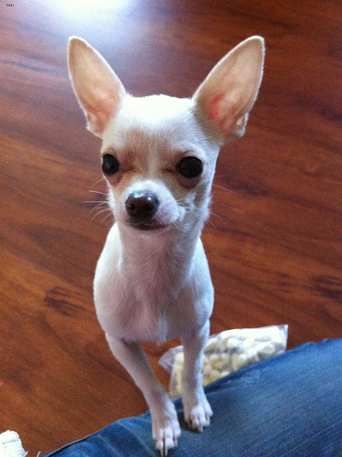
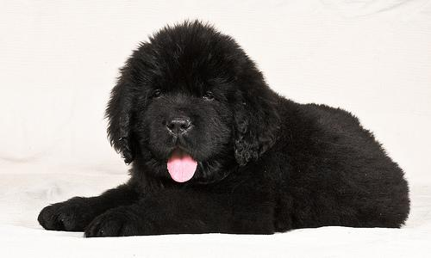
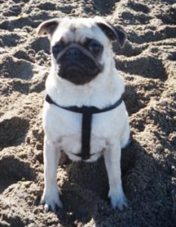
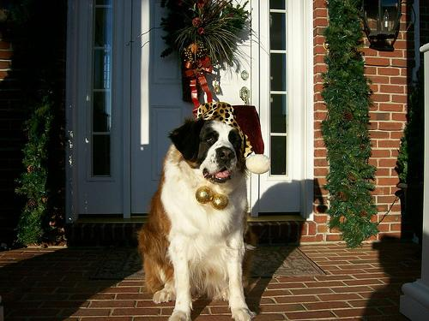
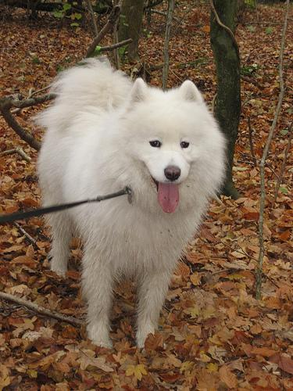
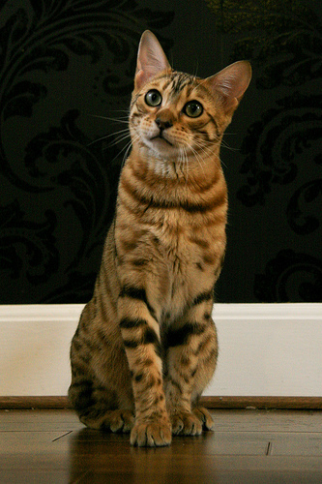
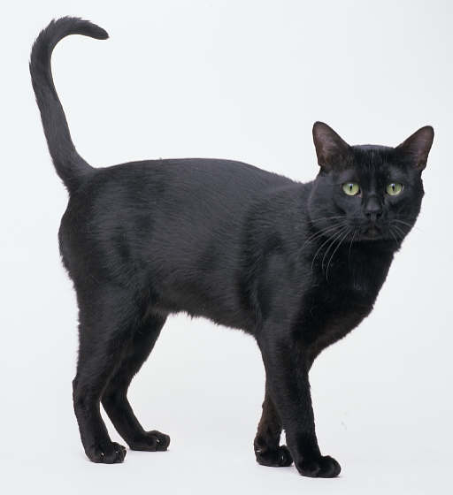
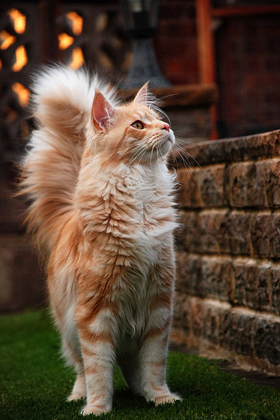
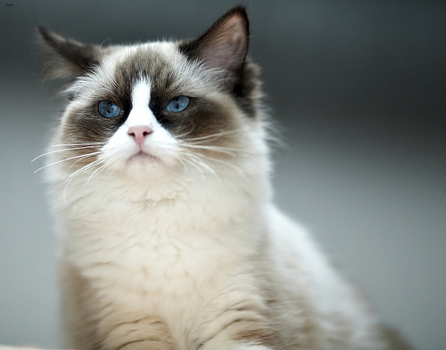
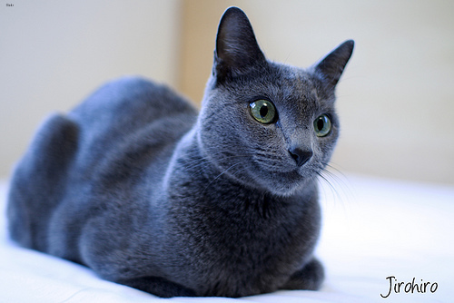
5 Dog Classes
Chihuahua
New Foundland
Pug
Saint-Bernard
Samoyed
5 Cat Classes
Bengal
Bombay
Maine Coon
Ragdoll
Russian Blue

Slide 4

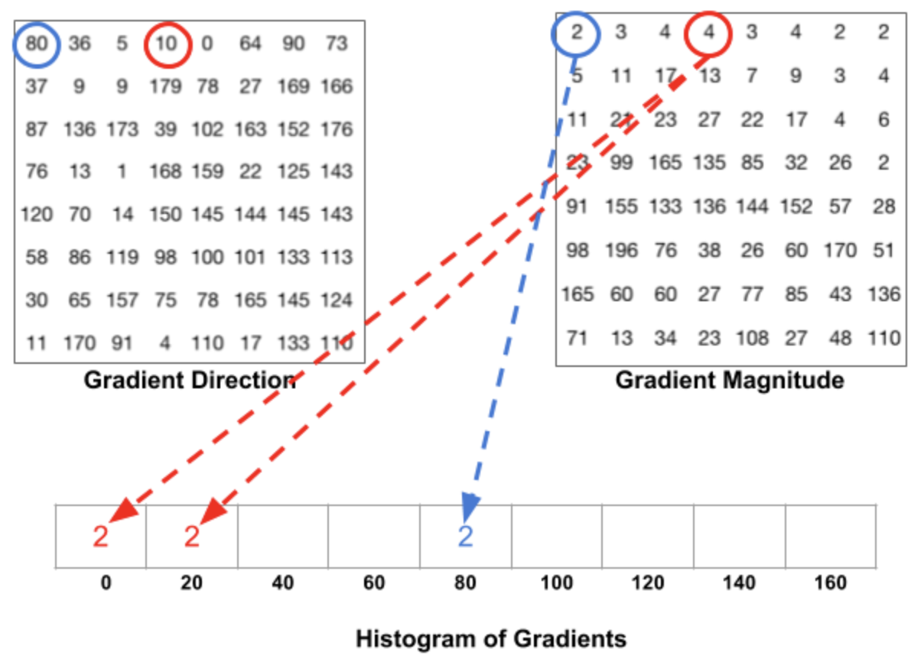
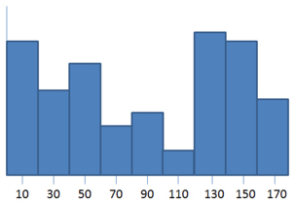
METHODOLOGY
HOG – Histogram of Oriented Gradients
Compute gradient value
Filtering the intensity of the image with the filter kernels: [-1, 0, 1], [-1, 0, 1]^{T}
Create cell histograms based on previous computed gradient
Group the cells together into larger, spatially connected blocks
Compute the normalized vector containing all histograms in a given block

Slide 5
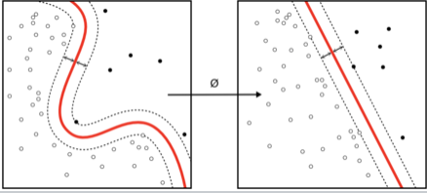
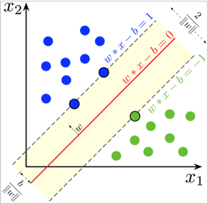
SVM – Support Vector Machine
Together with the HOG algorithm, take in a set of features labeled 0 or 1
Fit the SVM with training examples
SVM constructs hyperplane in the high dimension s.t. divide the vectors apart based on their labels

Slide 6
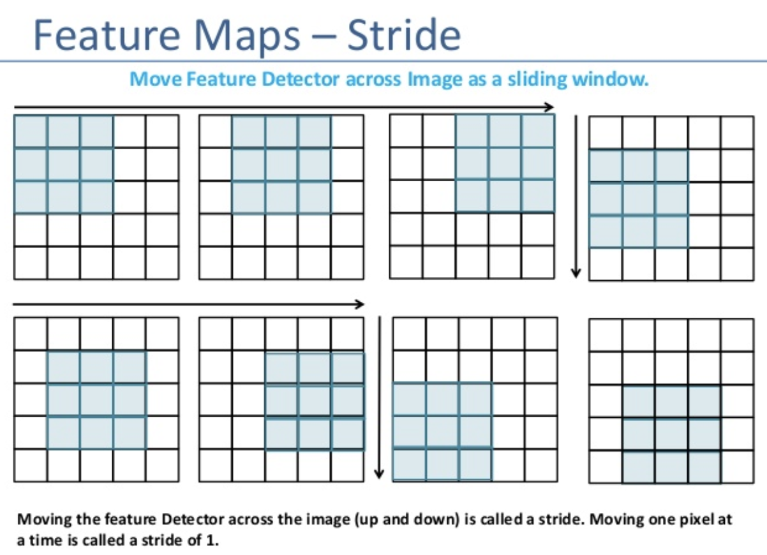
Sliding Window
Sliding the window through the image
Detect the object from the input image and combine with HOG to extract the feature vectors
And then extract the feature vectors into our trained SVM
Draw the rectangle of the window which labeled 1
Group the windows together into a larger bounding box

Slide 7
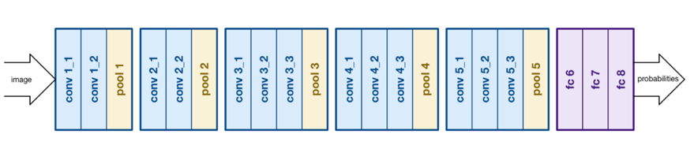
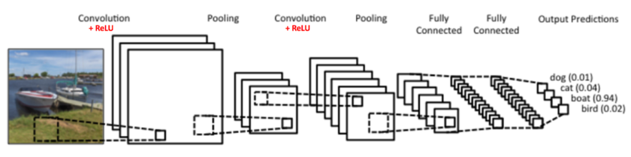
CNN – Convolutional Neural Network
Convolution
Non-linearity
Max pooling
Classification

Slide 8
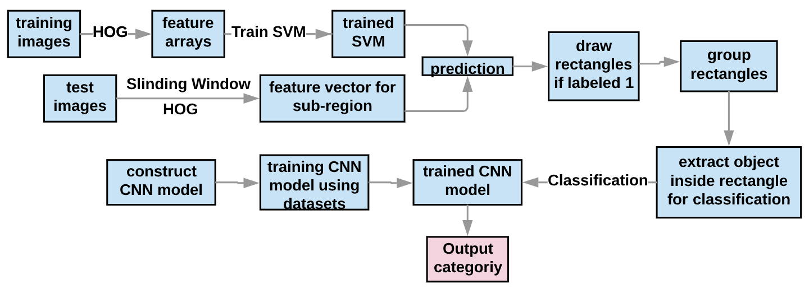
Results
General Pipeline of the Project

Slide 9
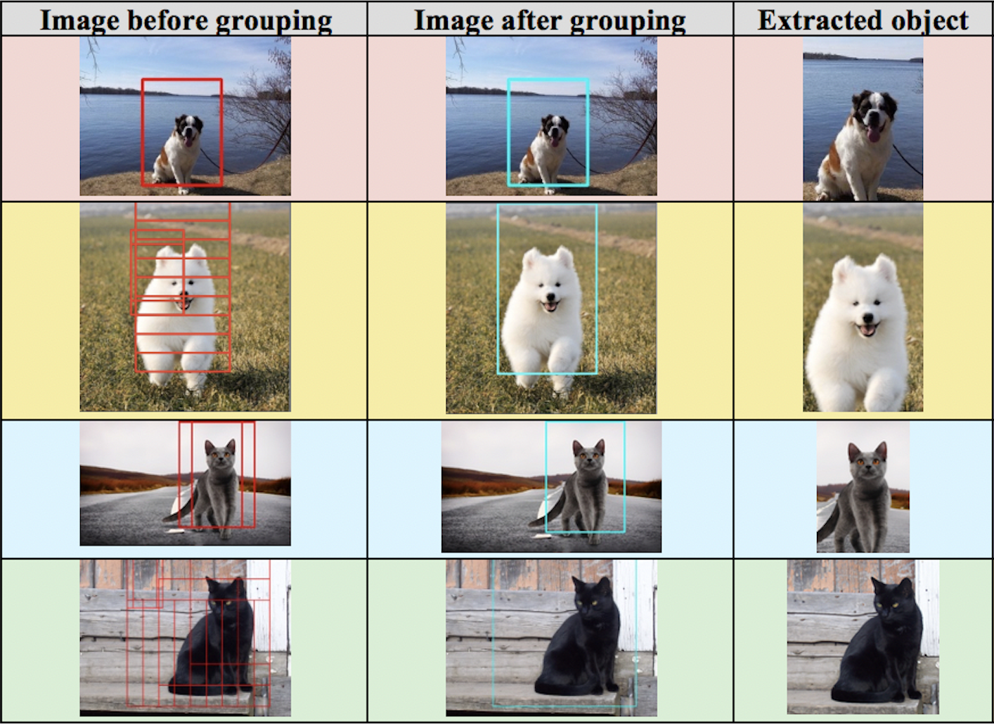
Detection Part Result

Slide 10
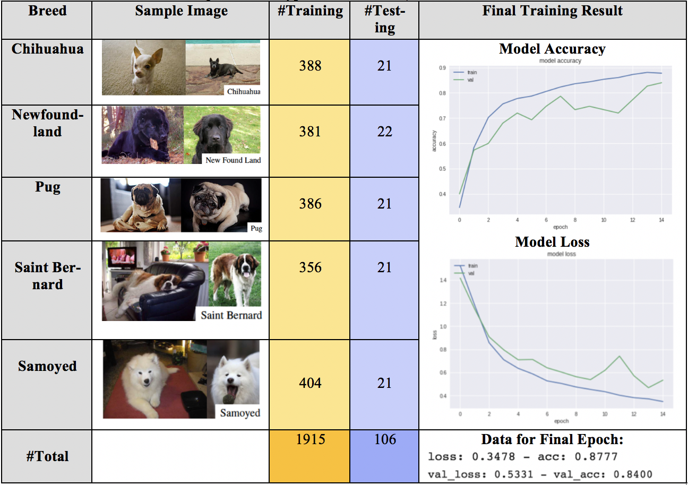
CNN Training Part Result

Slide 11
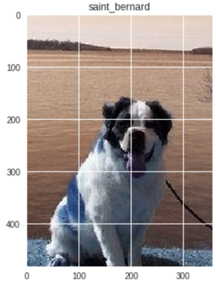
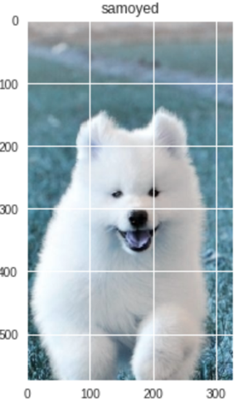
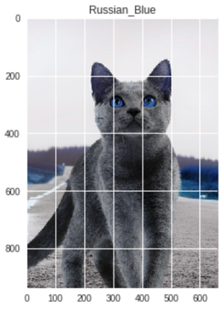
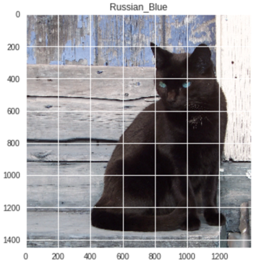
Final Result
Correct Classification
Correct Classification
Correct Classification
False
Positive

Slide 12
Comparison
Open Source Code for Detection Phase
OpenCV detector: https://www.pyimagesearch.com/2016/06/20/detecting-cats-in-images-with-opencv/
This method used cv2.CascadeClassifier to detect faces of cats. For grouping rectangles, it used detectMultiscale() function. CascadeClassifer is more accurate on detecting faces, but our method will detect a whole dog or cat instead of faces.
Open Source Code of CNN
Keras’ built-in VGG16 model: https://keras.io/applications/
Keras’ built-in SGD optimizer: https://keras.io/optimizers/
Keras’ built-in preprocessing ImageDataGenerator: https://keras.io/preprocessing/image/
These built-in methods just provide us some high level structure of the CNN model, in order to construct our own CNN model, we need to adjust the parameter and some convolution and dense layers in our modified version of the CNN model.

Slide 13
Coverage Topics
HOG
Use HOG algorithm to extract the features from the image using OpenCV built-in function HOGDescriptor, and we use this method to detect the objects in the images.
SVM
Use SVM algorithm together with enough positive and negative datasets to train the SVM model. SVM mechanism constructs a hyperplane and then use this space for classification.
CNN
Combine Keras’ VGG16 model with Keras’ optimizer SGD together to construct our own CNN model, training the model with enough datasets. Then we can use this trained model to classify the object for the detection part.

Slide 14
Individual Work
Yilin Qu
Construct the HOG descriptor
Build, train and compare SVM with different parameter settings
Perform a sliding window and use bounding box to extract dog or cat in the given image with trained SVM.
Yuhan Shao:
Construct the CNN model
Train the CNN model, and find the datasets
Find the positive and negative datasets for training the SVM model

Slide 15
Link to Project GitHub & Presentation

Slide 16
THE END
THANKS

